Slide 1
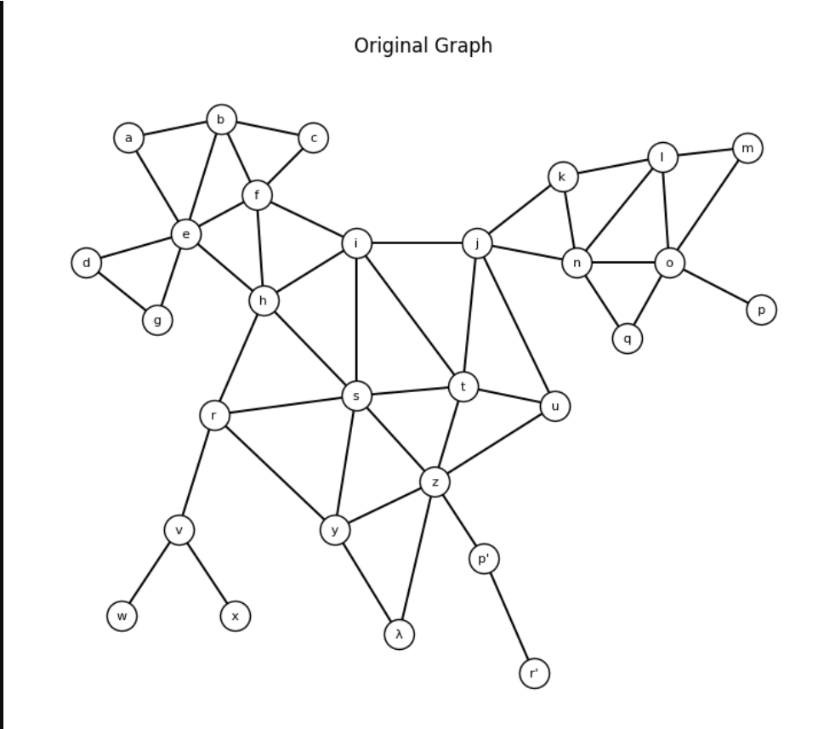
Problem: Graph Partitioning
Divide the vertex set V of G = (V, E) into k subsets V₁…Vₖ so that the objective function is optimized and the given constraints are satisfied.
Min-cut (k = 2): ||V₁| − |V₂|| ≤ 1, minimize the number of cut edges (nets).
1
Propose your own idea: a data structure + algorithm that reduces the number of cut edges
2
Code demo at the EDA Lab (11:00 or 13:00) and submit the file to the TA
3
PPT presentation at EDA Class (14:00): data structures, algorithms, complexity, comparison
Deadline: Oct 16 · Graph with 29 vertices, 49 edges
Notes:
Problem: split the graph into two balanced halves (differing by at most 1 vertex) so that the number of cut edges is minimal. The sample graph has 29 vertices, so the two parts have 15 and 14 vertices.

Slide 2
Problem Modeling
29
49
15 / 14
vertices |V|
edges |E|
valid sizes of the two parts
1
Adjacency list
2
Partition array
3
Objective function
adj[v] = the vertices adjacent to v. Traverse a vertex's neighbors in O(deg v).
side[v] ∈ {0, 1}. Move a vertex to the other part in O(1).
cut = number of edges (u, v) with side[u] ≠ side[v]; the cut must be minimized.
Notes:
Shared data structures for all algorithms: adjacency list, the side[] array, and a function that counts cut edges.

Slide 3
Three Methods Tested
Method | Cut | Balance | Complexity
Kernighan-Lin | 5 | 14 / 15 ✓ | O(n² log n) per pass
Spectral Bisection | 8 | 14 / 15 ✓ | O(n³); Lanczos O(k·E)
Exact Min Bisection | 5 | 14 / 15 ✓ | O(C(n, n/2)·E), NP-hard
Notes:
Overview comparison table: number of cut edges, balance, and complexity.

Slide 4
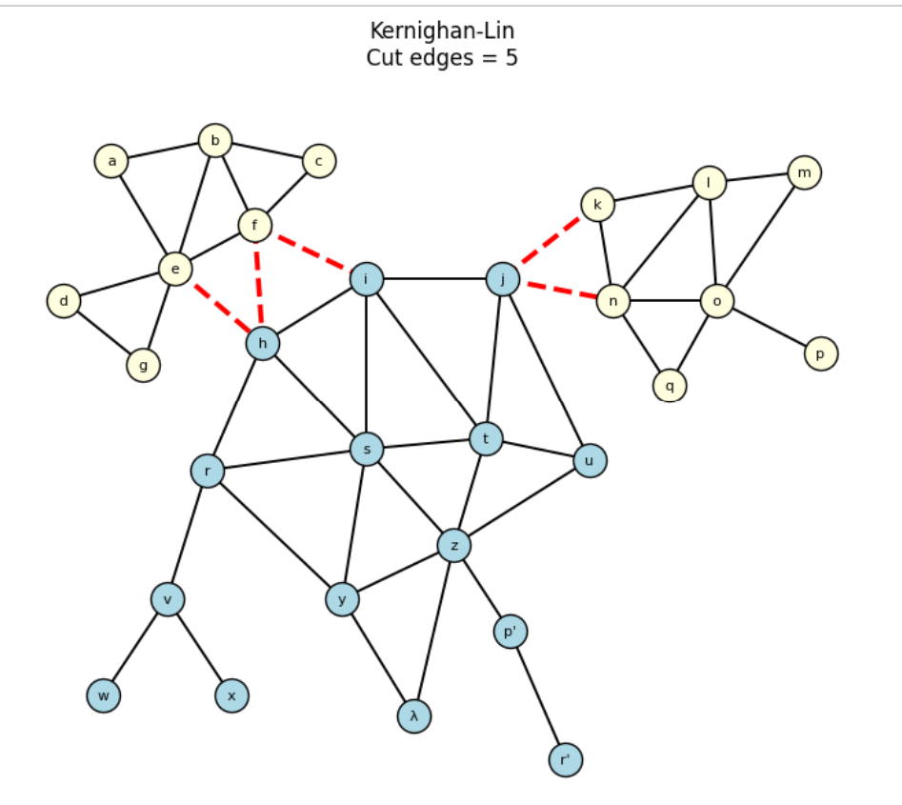
Kernighan-Lin (KL)
5
cut edges
Balanced 14 / 15 ✓
IDEA
Swap the vertex pair with the largest gain, lock the vertices, keep the best swap sequence.
DATA STRUCTURES
Adjacency list, gain array D[v], gain buckets (linked lists).
COMPLEXITY
O(n² log n) per pass; Fiduccia-Mattheyses variant with buckets: O(E).
Notes:
Kernighan-Lin: start from a balanced partition, compute gain D[v] = external − internal, swap the best pair, lock the vertices, repeat until no vertices remain, then pick the prefix with the largest total gain. Result: 5 cut edges.

Slide 5
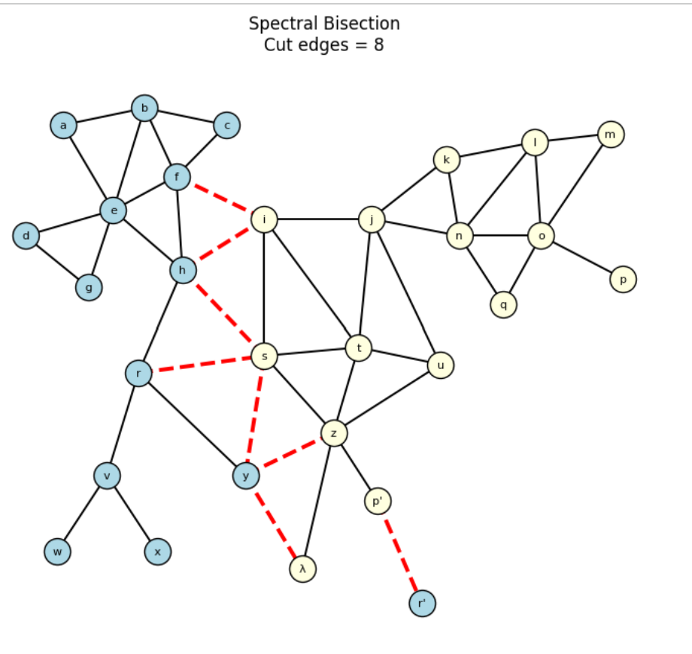
Spectral Bisection
8
cut edges
Balanced 14 / 15 ✓ but high cut
IDEA
Take the second eigenvector (Fiedler) of the Laplacian and split at the median.
DATA STRUCTURES
Adjacency matrix A, degree matrix D, Laplacian L = D − A.
COMPLEXITY
O(n³) for full decomposition; Lanczos O(k·E). Only an approximate solution.
Notes:
Spectral: relaxes the discrete problem into a continuous one, so it only gives an approximate solution; here it yields 8 cut edges.

Slide 6
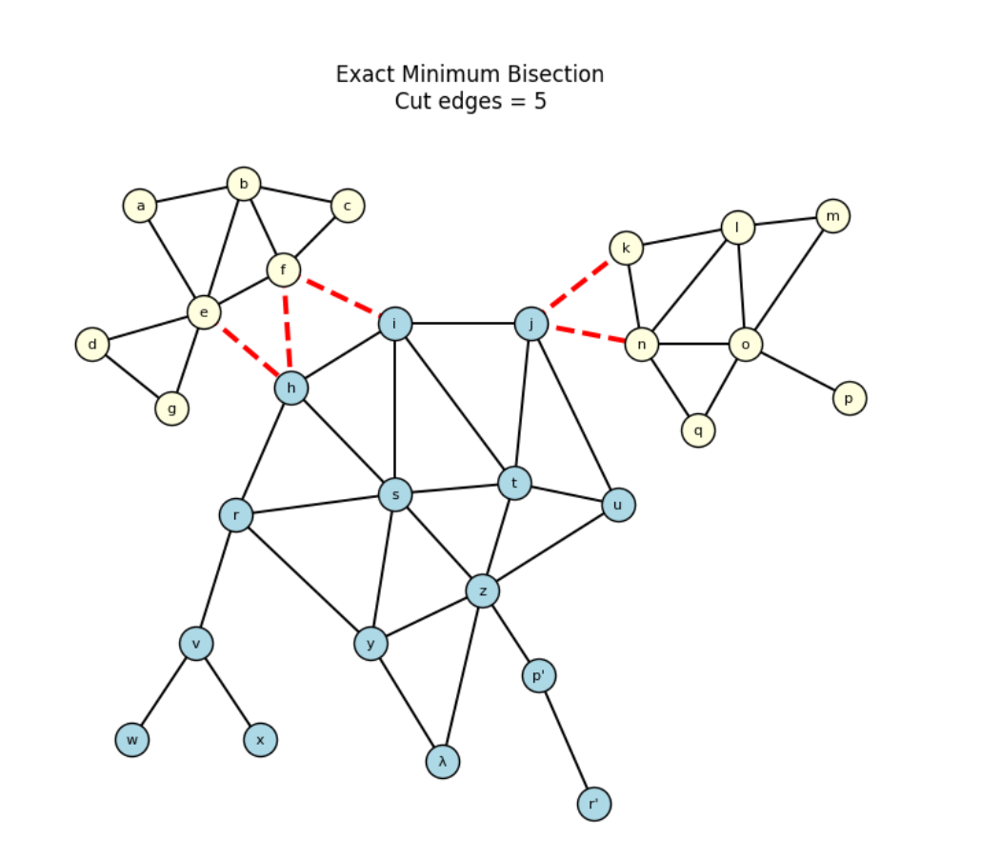
Exact Minimum Bisection
5
cut edges
Proven optimal ✓
IDEA
Enumerate every 15 / 14 split (≈ 7.8·10⁷ ways), with branch-and-bound pruning.
DATA STRUCTURES
29-bit bitmask for V₁; cut counted quickly via popcount on adjacency masks.
COMPLEXITY
O(C(n, n/2)·E). An NP-hard problem, feasible only for small n.
Notes:
Exhaustive search over C(29,14) = 77,558,760 splits gives the absolute optimum of 5 cut edges. Used as the benchmark to verify the other methods.

Slide 7
The Best Method
Absolute optimum
Exact Bisection: cut = 5. No balanced split does better.
Proposed solution
Kernighan-Lin: same cut = 5, same partition, runs much faster and scales.
Notes:
Exact gives the optimal bound = 5. Kernighan-Lin reaches exactly 5 at a much lower cost, so it is the proposed method.

Slide 8
Conclusion
1
Cut edges: e–h, f–h, f–i, j–k, j–n. Part V₁ consists of the clusters a…g and k…q.
5
2
Kernighan-Lin matches the Exact optimum (5) at low complexity, so it is chosen.
minimum cut edges with a 15 / 14 partition
3
Spectral (8) is only an approximation, so its cut is higher.
Future work: run KL many times from random starting points, or use FM for large graphs.
Notes:
Summary: the optimum is 5 cut edges; KL reaches the optimum at low cost.

